Slide 1



Confluence Basics
Larry Kline
Toronto Children’s Services
Version 9, August 2019

Slide 2
Introductions
Welcome to Confluence Basics!
About me:
Larry Kline, Training & Development Coordinator
Working for City of Toronto since 2004
Started with TCS (and Confluence) in 2014
About you:
Name and position
What have you used Confluence for?
What would you like to start using Confluence for?

Slide 3
Objectives
In this course we will:
Get comfortable with Confluence
Explore the features useful to you in your job
Start creating and editing your own pages
Learn how to get help and continued support
Have fun!

Slide 4
Session overview
Confluence Basics
Introductions
About Confluence
“Exploring and Finding”
(Break)
“Creating and Collaborating”
Questions
Conclusion
Notes:
Exploring and Finding – you don’t need be logged in to Confluence for this
Creating and Collaborating – you do need to be logged in for this

Slide 5
Definitions
Confluence (proper noun):
a popular computer application produced by Australian software company Atlassian

Slide 6
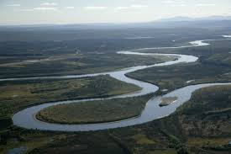
Definitions
confluence (noun):
1. a coming or flowing together, meeting, or gathering at one point;
2. the flowing together of two or more streams

Slide 7
About
Confluence

Slide 8
A bit of background…
Confluence for TCS
TCS purchased Confluence in 2012
First step was a pilot in IT Unit
Next step was “Policies on the Intranet” – storing TCS policies, forms and procedures in Confluence
In 2015, we migrated our intranet content into Confluence and launched a redesigned site
All TCS staff members with computer access can browse Confluence, find policies and forms, etc.
All TCS staff members are able to log in to Confluence (user profile is created upon first login)

Slide 9
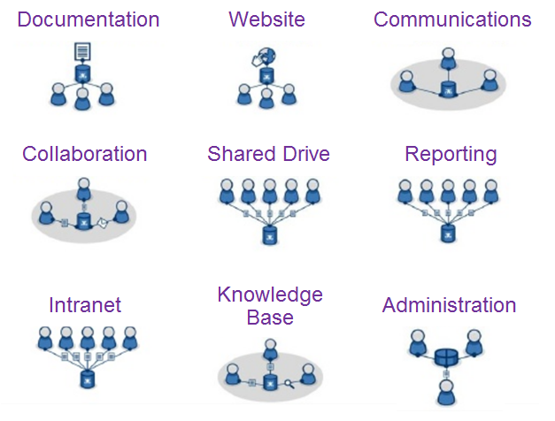
What can Confluence do?

Slide 10
What can Confluence do?
Things we use it for:
Policies and forms
Calendars and events
Project management
Meeting minutes
Blogs
Teamwork/collaboration features
Our TCS intranet site is on Confluence
(or in other words…)
Confluence software is the “engine” that we use to create and store our divisional content electronically

Slide 11
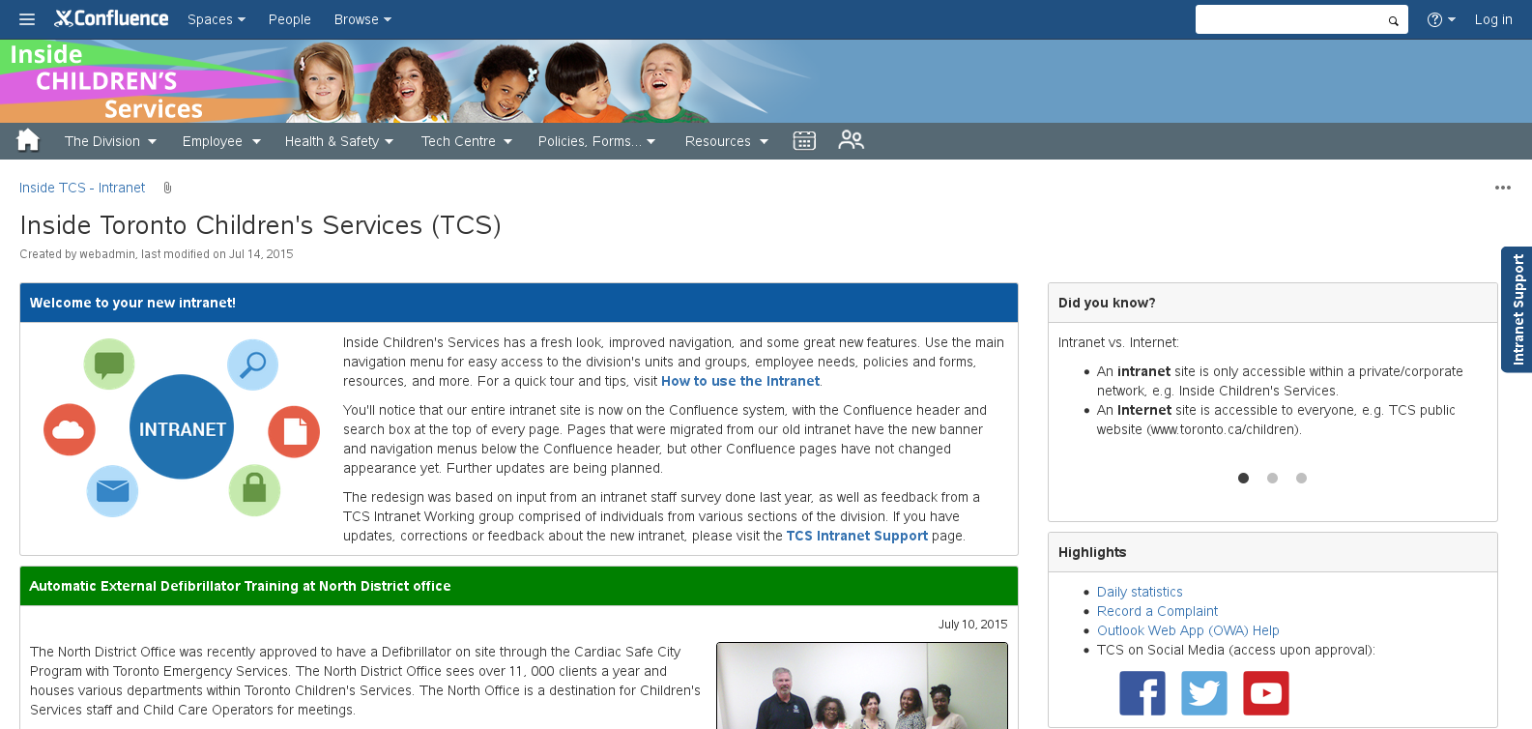
TCS intranet site
Intranet on Confluence
Since 2015, Confluence features and benefits have been available throughout the TCS intranet site
Intranet pages have TCS banner and navigation
“Non-intranet” Confluence pages do not have them

Slide 12
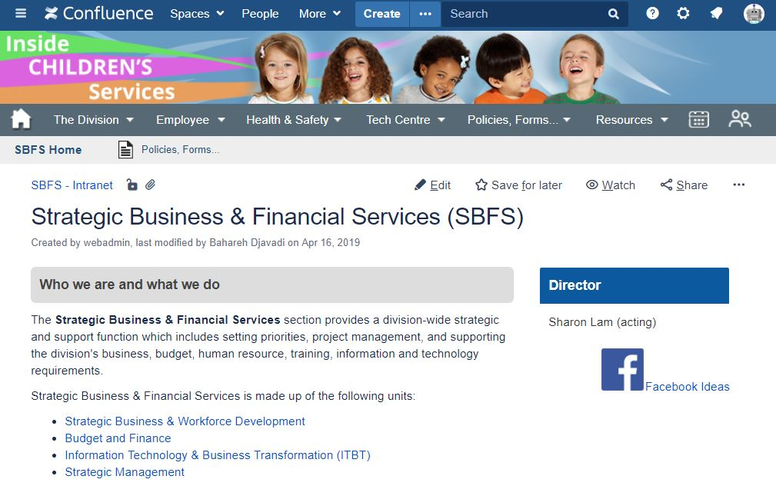
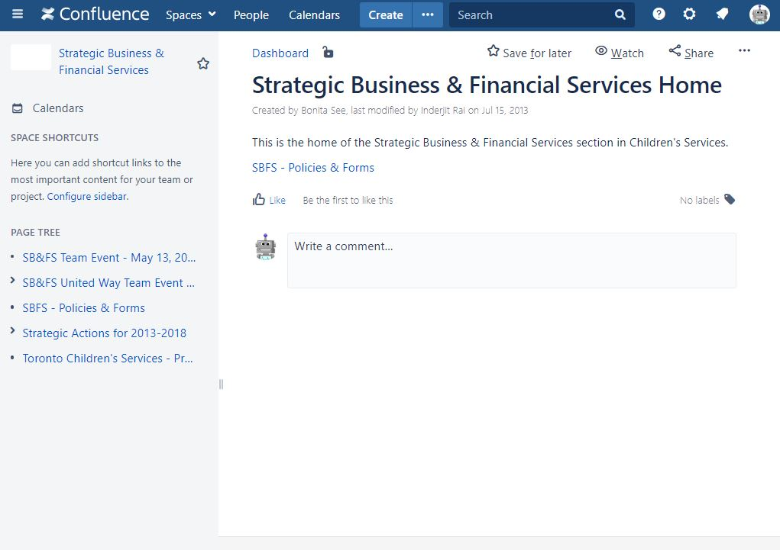
TCS intranet site
Intranet vs. “back-office” or project spaces
Intranet space | Back-office / project space
Information and resources on divisional units/groups and topics | Work and documents internal to a unit, group or project
Viewable by all | May be viewable by all (or not) and may have restricted pages/areas
Intranet navigation and banner; No sidebar | Sidebar; No intranet navigation and banner

Slide 13
Confluence benefits
Some key benefits for TCS:
Search engine – robust, with customizable parameters, and searches within attachments
Version management – change log/history, collaborative editing, and ability to revert to previous versions
Central knowledge repository – with automated web-link and comments management
Advanced functionality – modern features such as team calendars, sortable tables, decision registers, and blogs
Security infrastructure – supports a strong model to manage viewing/editing rights by user/role/unit
Ease of use – low learning curve so that non-technical users can navigate and create/update content

Slide 14
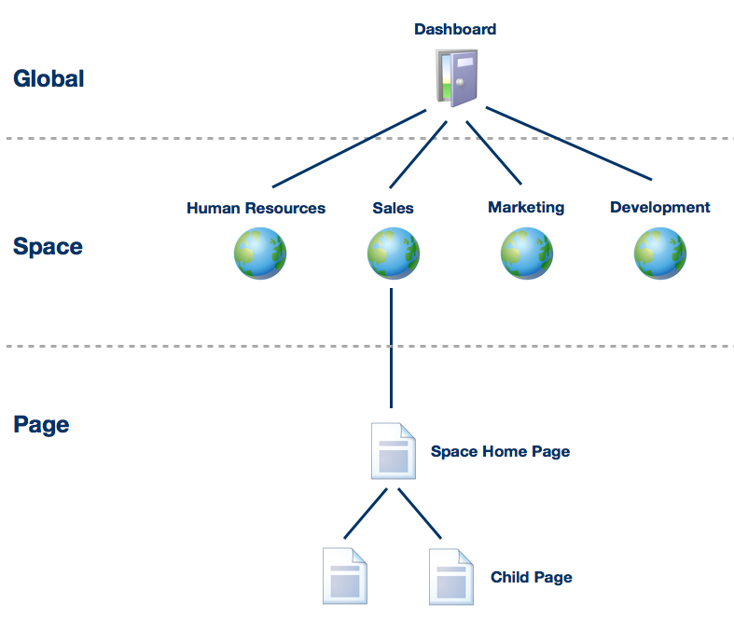


Basic concepts
Confluence is a wiki organized in spaces and pages
Wiki
Spaces
Pages
Notes:
Site Spaces vs. Personal Spaces
Each space has own homepage, blog and settings

Slide 15
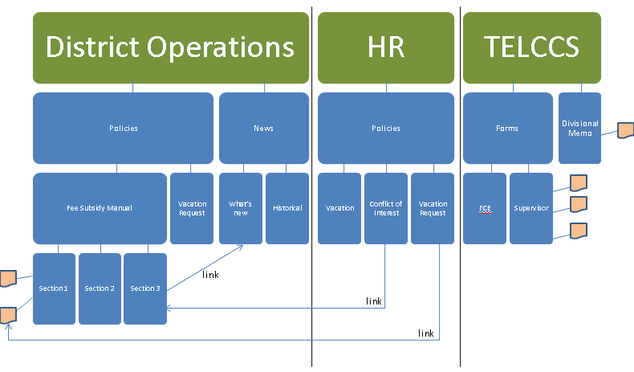
Basic concepts
Example of TCS spaces, pages, attachments and links
Homepage of a space
Sub-page within a space
Attachment on a page

Slide 16
Basic concepts
“Anonymous” vs. “Logged in”
Anyone on the City network (internal) can access and view Confluence as an anonymous user (i.e. without logging in)
Any TCS staff member can log in to Confluence to:
Work with their own profile and personal space
Create and edit content (pages, blogs, attachments, etc.)
View content restricted to specific users or groups
Use collaboration features (share, comment, like, etc.)
Note: Confluence use is for business purposes only and subject to the Acceptable Use Policy

Slide 17
Basic concepts
Permissions
Permissions are assigned to control which functions (e.g. create a page/space) are available to different user groups/roles
Permissions are set by a System Administrator at the global level and by Space Administrators at the level of individual spaces in Confluence
Restrictions
Restrictions allow content creators to control which specific users can view or edit a specific page
Access to a page/space can be granted by owner
Open is good - only restrict access when necessary

Slide 18
Exploring
and
Finding

Slide 19
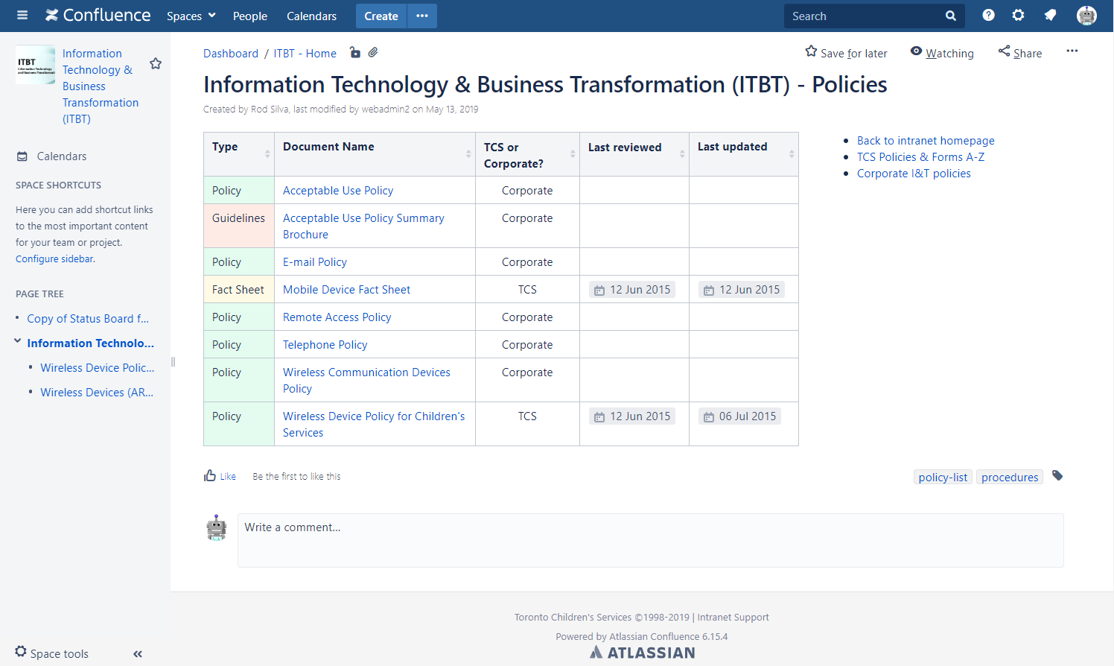

Page features
Confluence header bar
Page body
Sidebar
Notes:
Header bar
Sidebar – page tree/hierarchy
Body of page - breadcrumbs

Slide 20
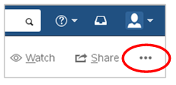
Page info and tools
Here are some of the options we have on a typical page in the “3 dots” (tools) menu:
View details about this page
Attachments
Page History
Restrictions
Page Information
View in Hierarchy
Export the page to PDF or Word
Notes:
Link to page
keyboard shortcut “k”
use Short URL
web tip: copy/paste

Slide 21

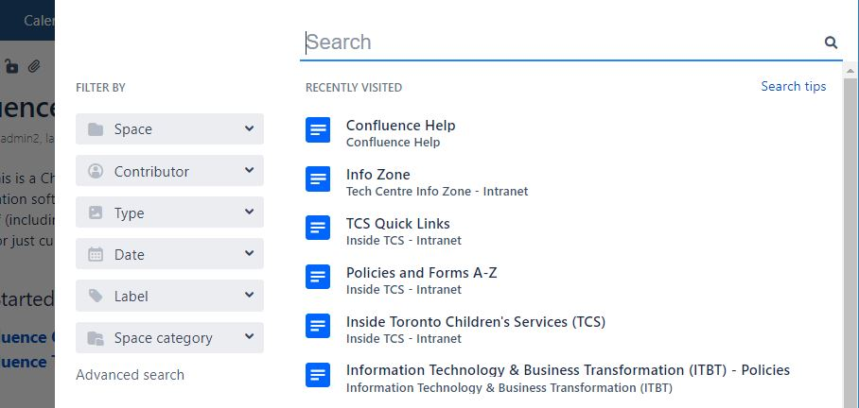
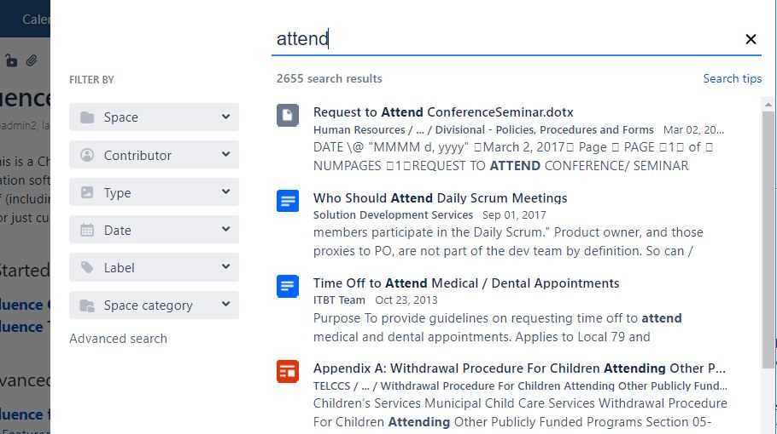
Searching
Basic steps to do a search in Confluence:
Click in the Search box to open the Search panel
If you’re logged in, it displays your Recently Visited pages and spaces
Start typing search terms – results display instantly
Filter the search results if necessary
By space, contributor, type, date, label, or space category
Notes:
Keyboard shortcut: /
Searches content of common attachments (Word, Excel, Powerpoint, PDF, text, HTML)

Slide 22
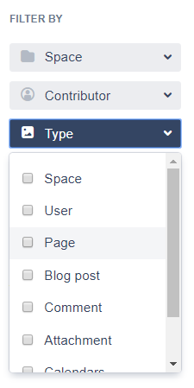
Searching
Filter search results by:
Space
Contributor
Type
Date
Label
Space category
Try filtering your search to a certain Space or a specific Type of content, e.g. Page or Attachment
Confluence even searches the text within common attachments (Word, Excel, Powerpoint, PDF, etc.)
Search is not case-sensitive

Slide 23
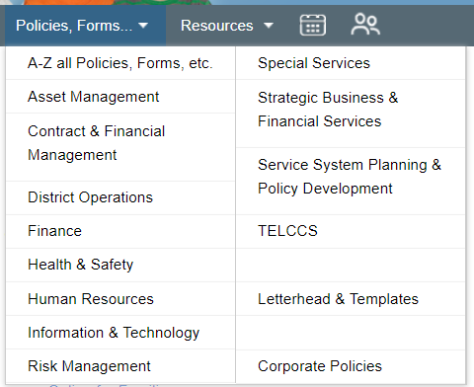
TCS policies and forms
Policies and forms on Confluence:
“Policies on the Intranet” project in 2013
Contributors and Approvers in each unit
Unit Policies pages and divisional A-Z

Slide 24
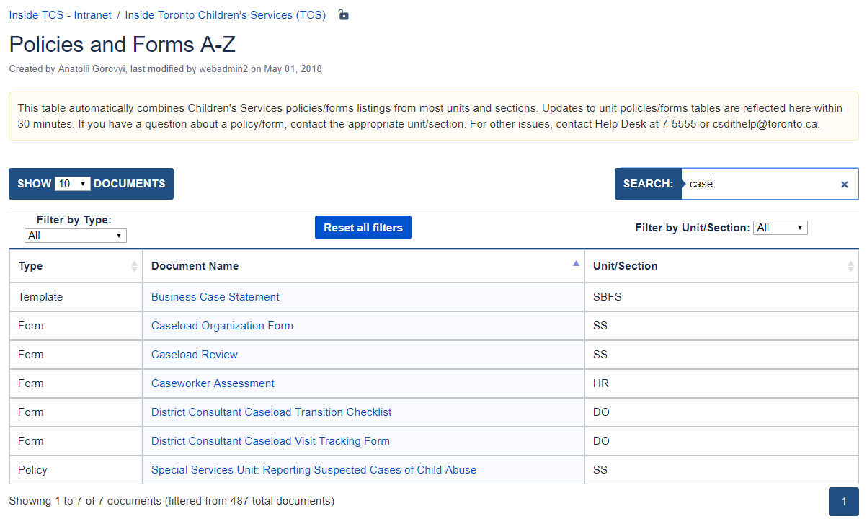
TCS policies and forms
How to find a policy or form:
On the divisional A-Z page, use the instant Search box or filter by Type or Unit/Section
On a unit policies page, you can sort the listings by clicking a column heading or use CTRL+F (Find) to search for a word on the page

Slide 25
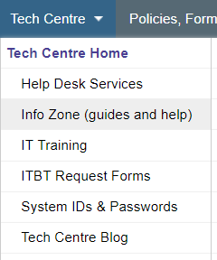
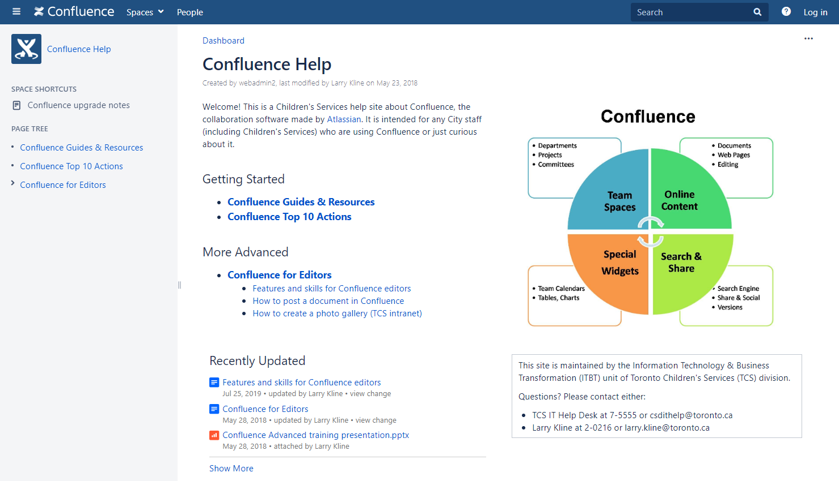
Getting help
TCS Confluence Help site:
On the intranet, look under Tech Centre >
Info Zone (guides and help)
or Search for “confluence help”
Find instructions, presentations, and more

Slide 26
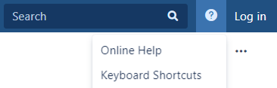
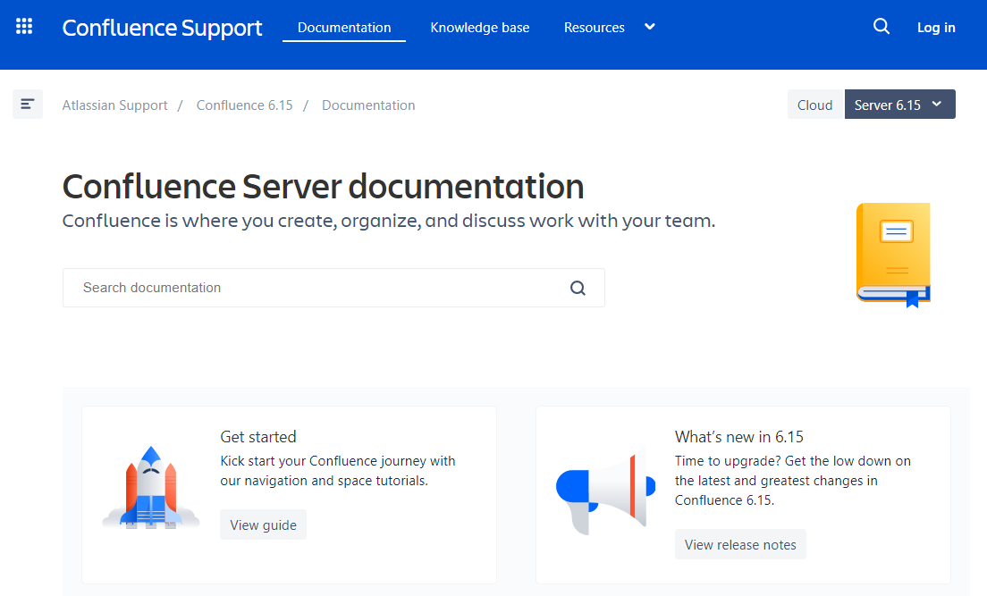
Getting help
Confluence User Guide:
Select “Online Help” from the Help menu
“Confluence Server documentation”
will open in a new browser tab
Search or browse for help topics

Slide 27
Creating
and
Collaborating

Slide 28
Creating and Collaborating overview
Creating / editing
Edit a page
Create a page
Add an attachment
Use personal space
Post to a blog
Collaborating
Share
Watch
Comment
Like
You must be logged in to use these features

Slide 29
“Logged in” features
Header level (right to left)
Profile menu (face icon)
Notifications (bell icon)
Search has recent pages
Create
Calendars
Page level
Save for later
Watch
Share
Edit (if permitted for current page)
Like and Comment (if enabled)

Slide 30

Editing and creating
Logged in under your ID:
Click your profile menu icon (top right)
Select/add the “Personal Space” option
Personal Space is where a user can publish their own pages and blog
It is a good place to try out editing and creating (can restrict pages to be viewable only to user)

Slide 31



Editing and creating
Edit a page
Click “Edit” option on page
Create a page
Click “Create” button in header
or “Create child page” in sidebar
Add an attachment
Click “3 dots” option on page and
select “Attachments”
or click “Files” while editing
Note: You can also “drag and drop” a file onto a page to upload

Slide 32
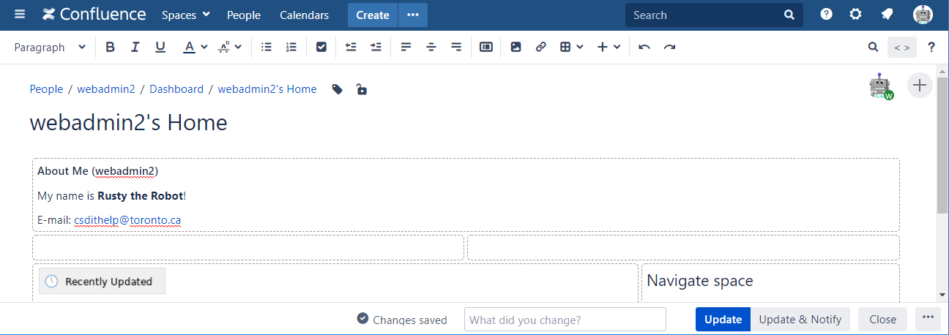
Editing and creating
The Confluence editor (“Edit mode”)
Preview – while editing, click “3 dots” to Preview, then back to Edit
Auto-saved drafts – editor shows “Changes saved” while editing
Publish / Update – when finished, use “Publish” if creating a new page or “Update” if editing an existing page
Update & Notify – will notify watchers/editors/commenters
Close – exits Edit mode but saves a draft (just in case)
Collaborative editing – if multiple editors, changes get merged

Slide 33


Collaboration features
Share
“Share” a page or blog post with selected users or groups, who will get a notification in Confluence and by email
You may include your own note (optional)
You will not have any record of sending the “share” (unless you include yourself when sending)
“Share” your page with yourself
and/or a friend
Look for the alert in your
Notifications (bell icon)

Slide 34

Collaboration features
Watch
“Watch” a page or blog post to get notifications of new/changed content, attachments and comments
You can watch (subscribe to) a blog or entire space
Useful for particular content or roles, but in general watching is not necessary (too many notifications) and sharing is a better practice
“Watch” a page that is not in your
Personal Space
Choose to watch either the page or
all content in the space

Slide 35



Collaboration features
Like and comment
“Like” a page
Add a comment to a page
Comments in Confluence should be of a professional nature
Save for later (i.e. favourite / bookmark)
Click “Save for later” on a page
Click your profile menu and select
“Saved for later” to see your
list of bookmarked pages
Notes:
Likes:
Author will receive notification
Enough likes will result in being listed as Popular Content (dashboard)

Slide 36
Conclusion
Getting help and support
TCS Confluence Help site (search for “confluence help”)
Confluence User Guide (online help - Atlassian)
TCS IT Help Desk (call 7-5555 or email csdithelp@toronto.ca)
Larry Kline (call 2-0216 or email larry.kline@toronto.ca)
Thank you!

